Slide 1
Stacks and Queues
Prof. Michael Tsai
2019/02/27

Slide 2
Stack
Stack represents an ordered and linear list
“Stack of plates”
Taken from and placed onto the top
Pop: take an element
Push: place an element
Example →
First in, ???? Out
1
0
5
4
1
0
4
1
0
3
4
1
0
4
1
0
Top
Bottom
A: Last
Therefore, Stack is a “First-In-Last-Out” (FILO) or ”Last-In-First-Out” (LIFO) data structure.
Notes:
Answer: 後

Slide 3
Stack Operations
So, what operations can be supported by a stack?
What parameters do they need?
Initialize a stack
Push an element
Pop an element
Is it empty?
Is it full?

Slide 4
Stack Usage Example: System Stack
A program uses a stack to store information about the calling function.
What are stored?
Activation record or stack frame
return address: where the calling function’s next instruction is located.
previous frame pointer: the location of the last stack frame (in the stack)
local variables
Example
Recursive call?
Stack overflow?
Previous frame pointer
Return address
Previous frame pointer
Return address
Local variables
Previous frame pointer
Return address
sp
fp
Notes:
Give a recursive function call example.

Slide 5
Stack Usage Example: Is it Palindrome?
If a word looks the same forward and backward.
Examples:
Noon, civic, racecar, madam
Was it a cat I saw
Q: how do we use a stack to check if a string is a palindrome?

Slide 6
Stack Usage Example: Balanced parentheses
Q: how do we use a stack to check if a string has balanced parentheses (each ‘(‘ is matched with a ‘)’ in the string.)?
Think about it!

Slide 7
How to implement a stack?
First version: using array
What else do we need except the array to store the data?
A variable to record the index of the top element.
How to implement these operations?
Push
Pop
Empty?
Full?
Number of current elements?

Slide 8
struct ArrayStack {
int top;
int capacity;
int *array;
};
struct ArrayStack *CreateStack() { struct ArrayStack *S = malloc(sizeof(struct ArrayStack));
if (!S) return NULL;
S->capacity=4;
S->top=-1;
S->array=(int*)malloc(S->capacity*sizeof(int))
if (!S->array) return NULL;
return S; }
Notes:
Top is the index of the largest array position with data.

Slide 9
int IsEmptyStack(struct ArrayStack *S) { return (S->top==-1); }
int IsFullStack(struct ArrayStack *S) {
return (S->top==S->capacity-1);
}

Slide 10
void Push(struct ArrayStack*S, int data) {
if (IsFullStack(S))
printf(“Stack Overflow”);
else
S->array[++S->top]=data;
}
int Pop(struct ArrayStack*S) {
if (IsEmptyStack(S)) {
printf(“Stack is Empty”);
return 0;
} else
return (S->array[S->top--]);
}
Notes:
Take extra time to explain ++S->top and S->top--

Slide 11
What if it is full?
array=(int*)malloc(S->capacity*sizeof(int));
If we have more than “capacity” elements, then it is full!
How do we enlarge the stack?
Hint: realloc() to the rescue!
realloc() can: (assume original size = n, new size = m)
Allocate a new chunk of memory, sized m (larger)
Move the content of the memory at the original location to the new location
Give you the address of the new memory
Q: How large should you realloc()?
Notes:
void *realloc(void *ptr, size_t size);
Zuvio: check parenthesis function

Slide 12
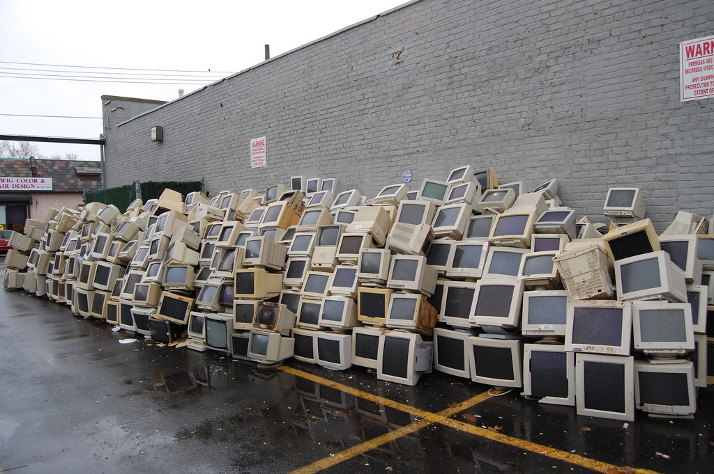
Monitor Stack

Slide 13
Queue
5
4
1
0
What is a queue?
Queue is also an ordered and linear list
But,
Add from the rear, take from the Front
Delete, or DeQueue: take an element
Add, or EnQueue: add an element
First-In-????-Out?
Rear
Front
A: First Out

Slide 14
Queue
So, what operations can be supported by a queue?
What parameters do they need?
Initialize a queue
Add an element (EnQueue)
Take an element (DeQueue)
Is it empty?
Is it full?

Slide 15
How do we implement a queue?
Let’s use array again
Record front and back of the queue in the array (indices)
But, here comes a problem:
The queue is full! But space is wasted.
How to solve this problem?
1 | 2 | 0 | -5
1 | 2 | 0 | -5 | 3
1 | 2 | 0
Front
Rear

Slide 16
Solution: circular array
4 | 2 | 0
4 | 2 | 0 | -5
4 | 2 | 0
4 | 2 | 0 | -5
5 | 2 | 0 | -5 | 3
4 | 2 | 0 | -5 | 3
Front
Rear
The end of the array is assumed “connected” to the start of the array
This makes sure that the number of elements which can be stored by a queue is the same as the size of the array
When is the queue empty?
When is the queue full?
Can we tell them apart?!
Notes:
A good way to remember:
Front == read pointer
Rear == write pointer

Slide 17
What if it is actually full?
We use realloc() to obtain a large chunk of memory.
Then, other work to be done?
It does not look right after realloc().
How do we fix this?
realloc from size to 2*size
0
size-1
2*size-1
5 |  | 0 | -5 | 3
5 |  | 0 | -5 | 3
Back
Front
Notes:
Zuvio: how to fix the example above and when we do not need to re-adjust the data?

Slide 18
Applications of Stack & Queue (if time permits)

Slide 19
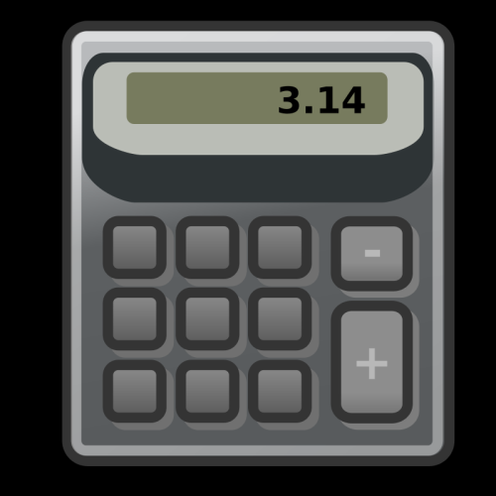
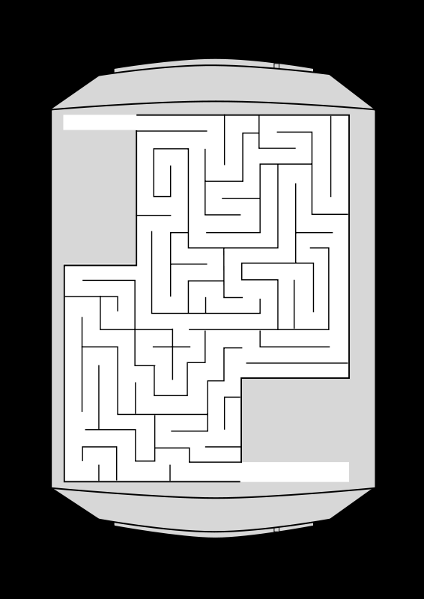
接下來講一些應用:
計算機問題
迷宮問題
(回家自己看)

Slide 20
應用一: 計算機
不是普通的計算機
題目: 如果打入一串如1+2*3-5/(4+5)/5的算式, 請寫一個演算法來算出這串算式的結果.
怎麼寫呢? 好複雜T_T

Slide 21
先來看看算式長什麼樣子
1+2*3-5/(4+5)/5
裡面有:
Operand – 1, 2, 3, 5, 4, 5, etc.
Operator – + * - /
括號– (,)
特色1: 左到右(left-to-right associativity)
特色2:一般這種寫法叫做infix (operator夾在operand中間)
先後順序要operator去”比大小”
例如乘除是大, 加減是小, 那麼就先乘除後加減

Slide 22
別種寫法: postfix
把operator放到兩個operands的後面
例如 2+3*4 →2 3 4 * +
a*b+5 → ?
(1+2)*7 → ?
a*b/c →?
(a/(b-c+d))*(e-a)*c→?
a/b-c+d*→?
e-a*c→?
Notes:
答案請見課本p131 Figure 3.13

Slide 23
Postfix有什麼好處?
沒有括號
用stack幫忙就可以很容易地算出結果!
例子: 6 2 / 3 – 4 2 * +
從左邊讀過去
讀到6, 放6進stack (stack: 6)
讀到2, 放2進stack (stack: 6 2)
讀到/, 取兩個operands (6和2), 算6/2, 然後答案放回去stack (stack: 3)
讀到3, 放3進stack (stack: 3 3)
讀到-, 取兩個operands(3和3), 算3-3, 然後答案放回去stack (stack: 0)
依此類推….

Slide 24
剩下來的”小問題”: infix to postfix
“小問題”: 怎麼把infix expression轉成postfix expression?
第一種方法: (適合紙上談兵)
1. 把整個expression
2. 把所有的operator都移到operand的後面去, 方便去除所有括號
3. 去除所有括號
但是實作上要怎麼做呢? (不希望做兩次)

Slide 25
又是一個可以利用stack解決的問題
方法:
1. 從左至右讀取expression
2. 碰到operand就直接輸出
3. 碰到operator時比較stack頂上的operator和目前讀到的operator哪一個比較”大” (precedence)
如果目前讀到的operator比較大, 就把operator放到stack裡
如果一樣大或者現在讀到的operator比較小, 就一直把stack裡面的operator拿出來印出來, 一直到stack是空的或者現在的operator比stack頂的operator大
為什麼可以這樣做?
裡面括號需要先印出, 但是卻是後讀到
比較外面的先用stack記起來, FILO, 由內而外
Notes:
precedence=優先性
Give an example
運算元operand
運算子operator
(壓上去的概念)

Slide 26
例子
怎麼把a+b*c利用前述方法轉換成postfix?
那麼, 如果碰到括號怎麼辦?
Notes:
a*b+c should also be explained

Slide 27
括號
括號內的有優先性
因此當碰到右括號的時候, 就立刻把stack中的東西一直拿出來直到碰到左括號為止
舉例: a*(b+c)
輸出的內容, stack內容(最右邊為top)
a
a, *
a, *(
ab, *(
ab, *(+
abc, *(+
abc+*

Slide 28
還有一些小問題
小問題1: 左括號的”大小”到底是多少?
碰到左括號一定要放進去stack →此時要是最大的
左括號的下一個operator一定要可以放進去→此時要是最小的
結論:
左括號有兩種”大小”
在stack內的時候優先性為最小
在stack外的時候優先性為最大
其他operator的優先性則不管在stack內外都一樣
Notes:
Example a*(b+c)

Slide 29
還有一些小問題
Q: 如何確保stack空的時候, 第一次碰到的operator可放進去?
A: 在stack底部放入一個虛擬operator帶有最低的優先性
Q: 如何確保讀到expression最後的時候, 可以把stack裡面未取出的operator都拿出來?
A: 字串最後可以加一個優先性最低的虛擬operator

Slide 30
例子
如何使用stack將 a+b*(c+d)/e 轉換成postfix表示方法。

Slide 31
最後來一個有趣的迷宮問題吧
迷宮: 0是路, 1是牆壁. 每一部可以往上、下、左、右和四個斜角方向走一步.
問題: 怎麼找出一條路從(0,0)走到(7,7) ? (不一定要最短)
提示: 跟stack是朋友
 | 0 | 1 | 2 | 3 | 4 | 5 | 6 | 7
0 | 0 | 1 | 1 | 1 | 1 | 0 | 1 | 1
1 | 0 | 0 | 0 | 0 | 0 | 0 | 0 | 1
2 | 1 | 1 | 1 | 1 | 1 | 1 | 1 | 0
3 | 1 | 0 | 0 | 0 | 0 | 0 | 0 | 1
4 | 0 | 1 | 1 | 1 | 1 | 1 | 1 | 1
5 | 0 | 0 | 0 | 1 | 1 | 0 | 1 | 0
6 | 0 | 1 | 0 | 1 | 0 | 1 | 0 | 1
7 | 0 | 1 | 1 | 0 | 1 | 1 | 1 | 0

Slide 32
走迷宮的時候, 人要怎麼走?
最重要的時候, 是碰到岔路的時候
先記起來, 選其中一條走走看
如果碰壁了 (一直沒有走到終點), 就退回最後一次碰到的岔路, 換另外一條岔路
關鍵字: 最後一次碰到的岔路 (不是最先碰到的)
所以是先進後出→使用stack
關鍵字: 換另外一條岔路
要記得上一次走過哪一條路了

Slide 33
一些細節
Q: 那麼, stack裡面要存什麼呢?
A:
“岔路”的地方的
座標, 也就是(row, col)
試過那些岔路了(試到八個方向的哪個方向了)
Q: 要怎麼預防繞圈圈? (永遠出不來)
A: 標示所有已經走過的地方, 走過就不用再走了
<注意> 這是因為不用找”最短”的路

Slide 34
讓我們來寫algorithm
把(row_start, col_start, 第一個方向) 放入stack
while(stack不是空的) {
從stack拿出一組岔路點(row, col, dir)
while(還有別的dir還沒試) {
將(row, col)往dir方向移動, 得到(row_n, col_n, dir).
如果(row_n, col_n)就是終點, 則結束
如果(row_n, col_n)不是牆壁且沒有來過 {
標示(row_n, col_n)來過了
把(row, col, dir的下一個方向)放入stack
row=row_n; col=col_n; dir=第一個方向;
}
}
}

